Slide 1
COMP 122/L: Computer Arch. and Assembly Language Instructor: Mahdi Ebrahimi Summer 2020 – Session 3

Slide 2
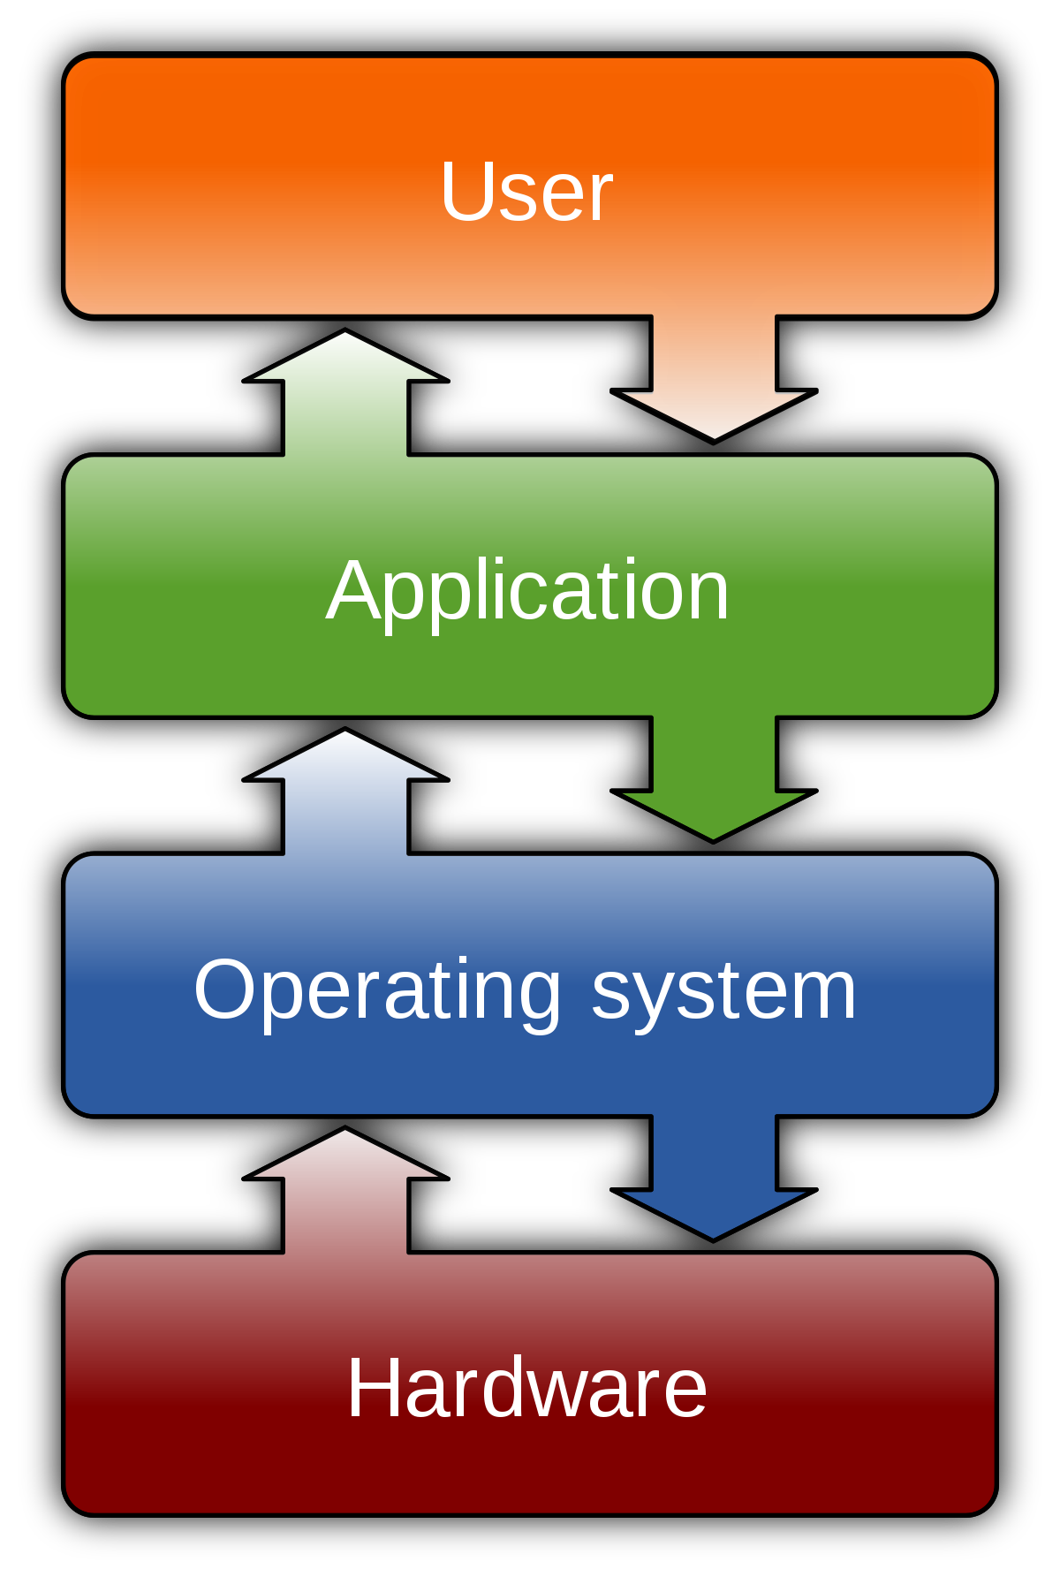
Lecture Plan
Introduction
About the instructor
About the course

Slide 3
About me
August 2019 – present: Assistant Professor at CSUN Computer Science Department
September 2017 – July 2019: Assistant Professor at LTU Math. And Computer Science Department
August 2017: Ph.D. from Wayne State University, Detroit, Michigan, Big Data Research Lab
Dissertation: “Data Placement And Task Mapping Optimization For Big Data Workflows In The Cloud”

Slide 4
Big Data Management: Parallel processing of big data, optimal data partitioning and placement in the Cloud, Cloud-based workflow task mapping, big data workflows scheduling.
Instructor’s research interests

Slide 5
About me
Homepage:
https://mebrahimii.github.io
Email:
mahdi.ebrahimi@csun.edu

Slide 6
About you
Your program: B.S. vs M.S.
Your department: (CS, CE, …)
Favorite programming language(s):
Java
C/C++
Assembly
Python
Operating System:
Linux
Windows
macOS
Prerequisites
COMP 110/L
MATH 103, MATH 104, MATH 105, MATH 150A or MATH 255A
(please email me if you have any difficulties to access computers and internet. )

Slide 7
Teaching Style
Share with me your learning experiences about your online classes in the last semester (spring 2020)
What online teaching methodologies do you prefer?
Synchronized
Asynchronized
Combination of both
Is there any time difference between you and the class time? How many hours?

Slide 8
Logistics
Lectures/Labs:
MTuWTh, 09:00 - 09:35 AM, online via Zoom
MTuWTh, 09:45 - 11:20 PM, online via Zoom
Office hours:
Instructor: Monday and Wednesday, 11:30-12:30pm, via Zoom (email me to schedule it)
Feel free to email me at any time with minor questions, major questions are for office hours

Slide 9

Zoom Lecture Policy
In the event the course is held online, students will be required to appear on webcam during lectures and exams.
For students who feel this is a violation of their privacy, they can take steps to create a neutral background, either physically or electronically.
For any student who still objects, the instructor may be able to grant exceptions if the student provides the instructor with a reasonable justification for why the policy is not acceptable. Requests for exceptions will be considered on a per student basis.

Slide 10

Course structure
Course contents:
Computer architecture
Assembly language programming
Number systems and data representation
Internal organization of a computer
Primitive instructions and operations
Workload:
Labs
Midterm exams
Final exams
Grading (single combined grade ):
Labs – 30%
Lab midterm exam – 15%
Lecture midterm exam – 15%
Lab final exam – 20%
Lecture final exam – 20%

Slide 11
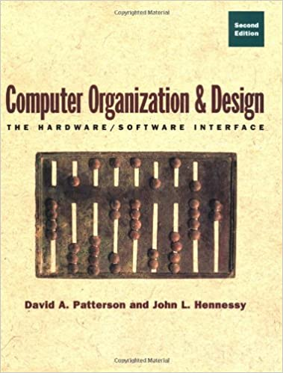
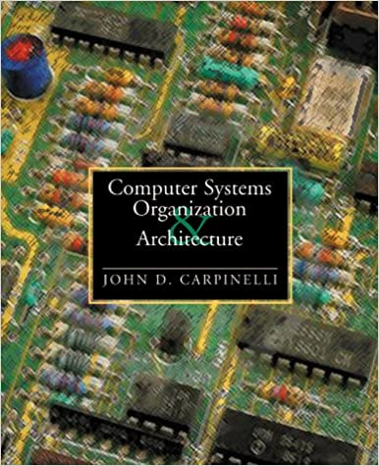
Textbooks
No textbook is required. If you’d like a textbook for further study,
two decent supplemental textbooks are:
[1] Computer Organization and Design: The Hardware/Software Interface
(any edition from the past several years)
David A. Patterson and John L. Hennessy
[2] Computer Systems Organization and Architecture
John D. Carpinelli
[3] ON-LINE RESOURCES:
Class Canvas
Class announcements, updates to schedule and assignments, useful links, etc.

Slide 12
Goals of COMP 122/L
A successful student will learn basic assembly programming skills, understand the fundamentals of digital logic design, and understand the interface between the two. The ARMv4 instruction set will be used for assembly, though the concepts are broadly applicable. In particular, successful students will be able to:
Describe how modern computers represent numbers, and interconvert between different numeric representations
Perform common operations over computer-represented numbers, and design circuits which perform these operations
Write programs in ARM assembly, including conditionals, loops, arrays, and functions
Design and simplify combinatorial circuits with Boolean algebra and Karnaugh maps
Design sequential circuits, including those implementing finite state machines
Design a simplistic processor implementing a restricted assembly language
Understand, from a high-level, the design of a high-level processor

Slide 13

Exams
Midterm and Final Exams will be online via Canvas
Test overall comprehension and general knowledge

Slide 14


Lab Assignments
Individual and submit your own work
For lab assignments (and only lab assignments), students may discuss among each other, as long as they don’t share actual solutions (this forbids digitally sharing code). That is, you cannot simply copy someone else’s solution.
The only stipulation is that if you do discuss with someone else, say so in your submission.

Slide 15
Late Policy

Slide 16
Schedule
Week | Dates | Topics
1 - 2 | 7/08 - 7/09 | Number representation
2 - 1 | 7/13 - 7/14 | Floating point, operations on binary values
2 - 2 | 7/15 - 7/16 | ARM assembly: introduction and arithmetic
3 - 1 | 7/20 - 7/21 | ARM assembly: conditionals and memory operations
3 - 2 | 7/22 - 7/23 | ARM assembly: loops and arrays
4 - 1 | 7/27 - 7/28 | ARM assembly: functions
4 - 2 | 7/29 - 7/30 | More ARM assembly; review
5 - 1 | 8/03 - 8/04 | 8/3 Lab Midterm Exam 8/4 Lecture Midterm Exam 9:00 AM - 11:00 AM, Online via Canvas
5 - 2 | 8/05 - 8/06 | Boolean logic and introductory combinatorial circuits
6 - 1 | 8/10 - 8/11 | Simplifying circuits with Boolean algebra and K-maps
6 - 2 | 8/12 - 8/13 | Sequential circuits, Finite state machines Processor control units
7 - 1 | 8/17 - 8/18 | 8/17 Lab Final Exam 8/18 Final Lecture Exam 9:00 AM - 11:00 AM, Online via Canvas

Slide 17

Let’s Go!!

